Slide 1
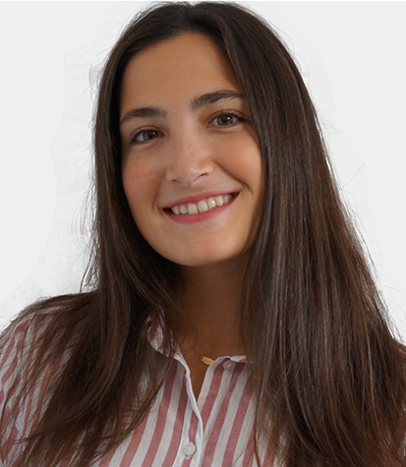
Laboratory 10
Distillation
Laia Tarrés
laia.tarres@bts.tech
MsC Student
UPCTech -> Researcher at BBC & IRI

Slide 2

Reminder
Is this webinar being recorded?

Slide 3
Introduction
State-of-the-art architectures are HUGE.
But the speed of inference is important as well as training time and resources.
Small models present a significant challenge. But in practice, small and fast models are preferable.

Slide 4
Distillation
To optimize the costs, 3 main methods have emerged to compress the models:
Weight pruning
Quantization
Knowledge distillation

Slide 5
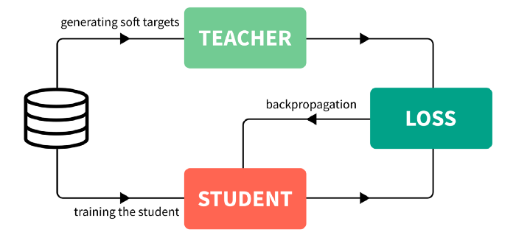
Distillation
Knowledge Distillation is a procedure for model compression, in which a small (student) model is trained to match a large pre-trained (teacher) model.
Knowledge is transferred from the teacher model to the student by minimizing a loss function, aimed at matching softened teacher “logits” as well as ground-truth labels.
At the end we have a model compressed that is able to learn the task.
Geoffrey Hinton, Oriol Vinyals, and Jeff Dean: Distilling the Knowledge in a Neural Network

Slide 6
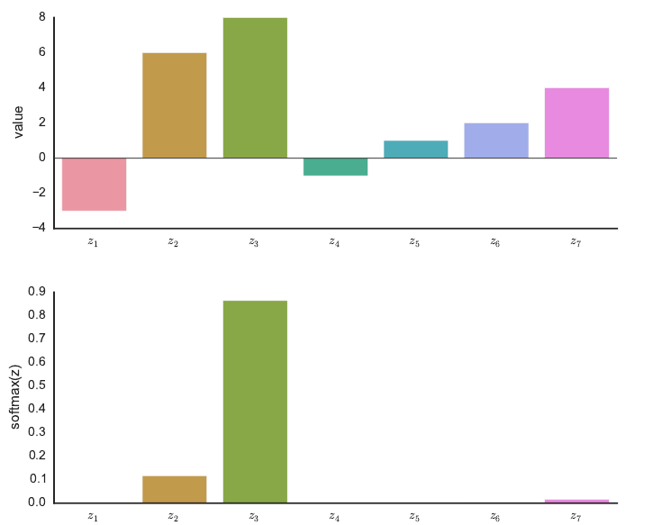
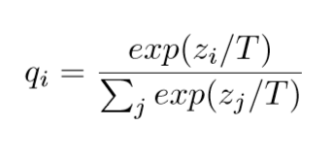
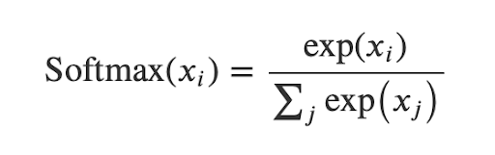
Distillation
To implement it, they compare the output from the softmax of both networks.
They introduce the idea of Temperature, which the higher value it has, the softer the probability of distribution over classes.
Temperature scaling
softmax

Slide 7
Lab session
In these lab exercises we are going to see:
1. What is distillation.
2. How to distill a teacher model into a student one.
3. The benefits of distillation and temperature scaling.

Slide 8


Kick off the lab
Launch a web browser (Chrome recommended).
Login to a Google account. Create a new one if preferred.
Open this notebook, create a copy in your own Drive, and open the copy.
Change runtime type to work with GPU.

Slide 9


